Slide 1
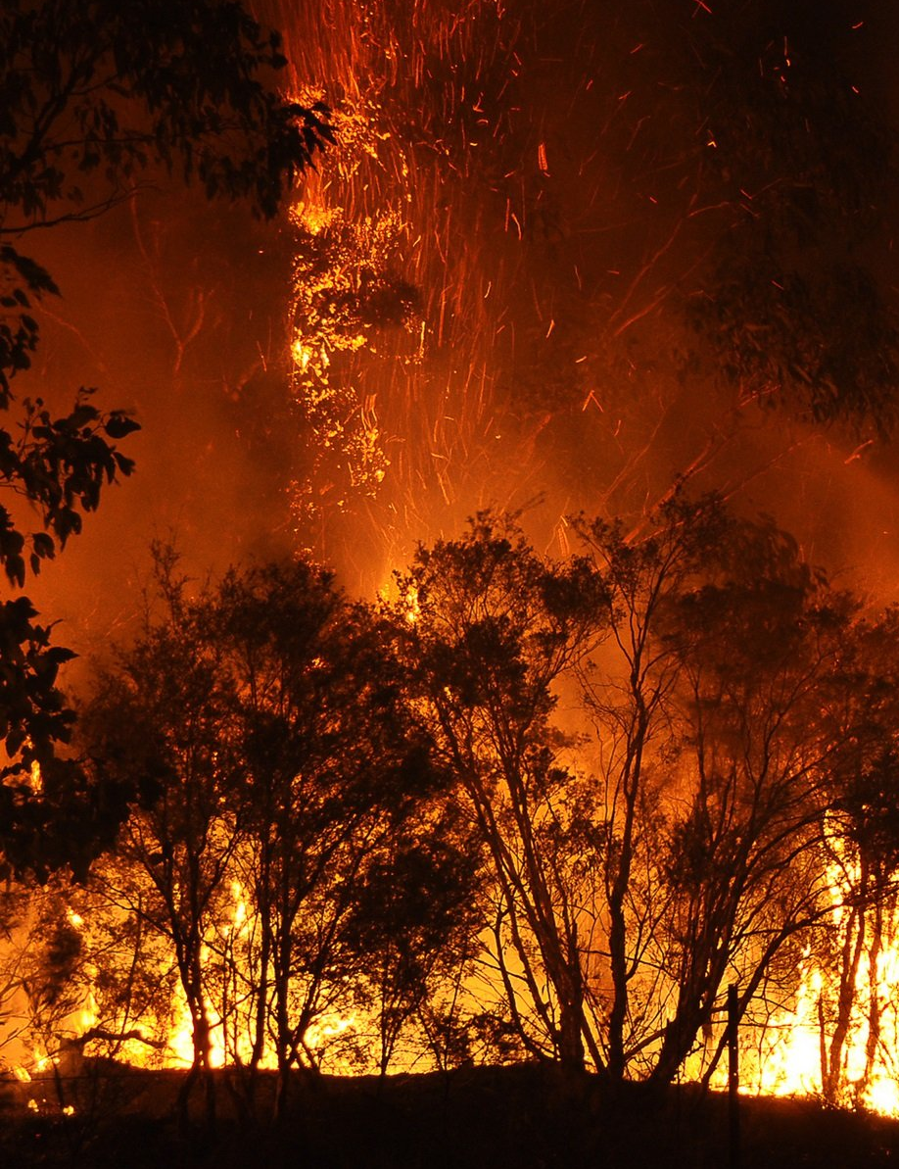
CATCHING FIRE… Before it Catches Us
A Wildfire Prediction Model
By Tina Salihu

Slide 2
Contents
01
Introduction
02
Objective
03
Data
Overview of wildfire risks and the problem to solve
Introduce the problem and objective
Data source and EDA
The Model
05
Future Proofing
06
Conclusions
04
Creation and evaluation of the model + demo
Limitations of the model
Findings and conclusion

Slide 3
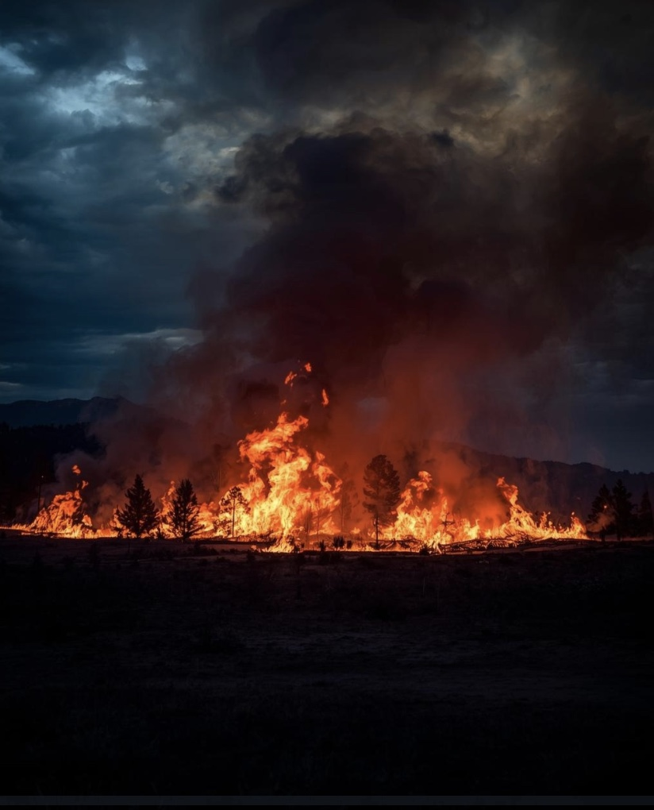
INTRODUCTION
What is a Wildfire?
An uncontrolled fire that burns vegetation in natural areas like forests or grasslands.
What are the Risks Associated with Wildfires?
Injury and loss of life
Destruction of habitats and wildlife
Economic loss

Slide 4

OBJECTIVE
How can we help to prevent these risks?
Build a predictive model!
OBJECTIVE: Build a classification model that takes
information about environmental factors and
calculates the probability of a wildfire occurring.
This can be used to send warning messages to help with planning and risk-management.

Slide 5

EXPLORATORY DATA ANALYSIS
The dataset chosen was a CSV file from Kaggle, but was originally scraped from NASA and Open-Meteo:
15 Features
Target Column: ‘Occurred’
Includes temperature, wind speed, humidity.
Represent measurements over a one-hour period.
Binary classification, i.e. 0 = No Wildfire, 1 = Wildfire

Slide 6
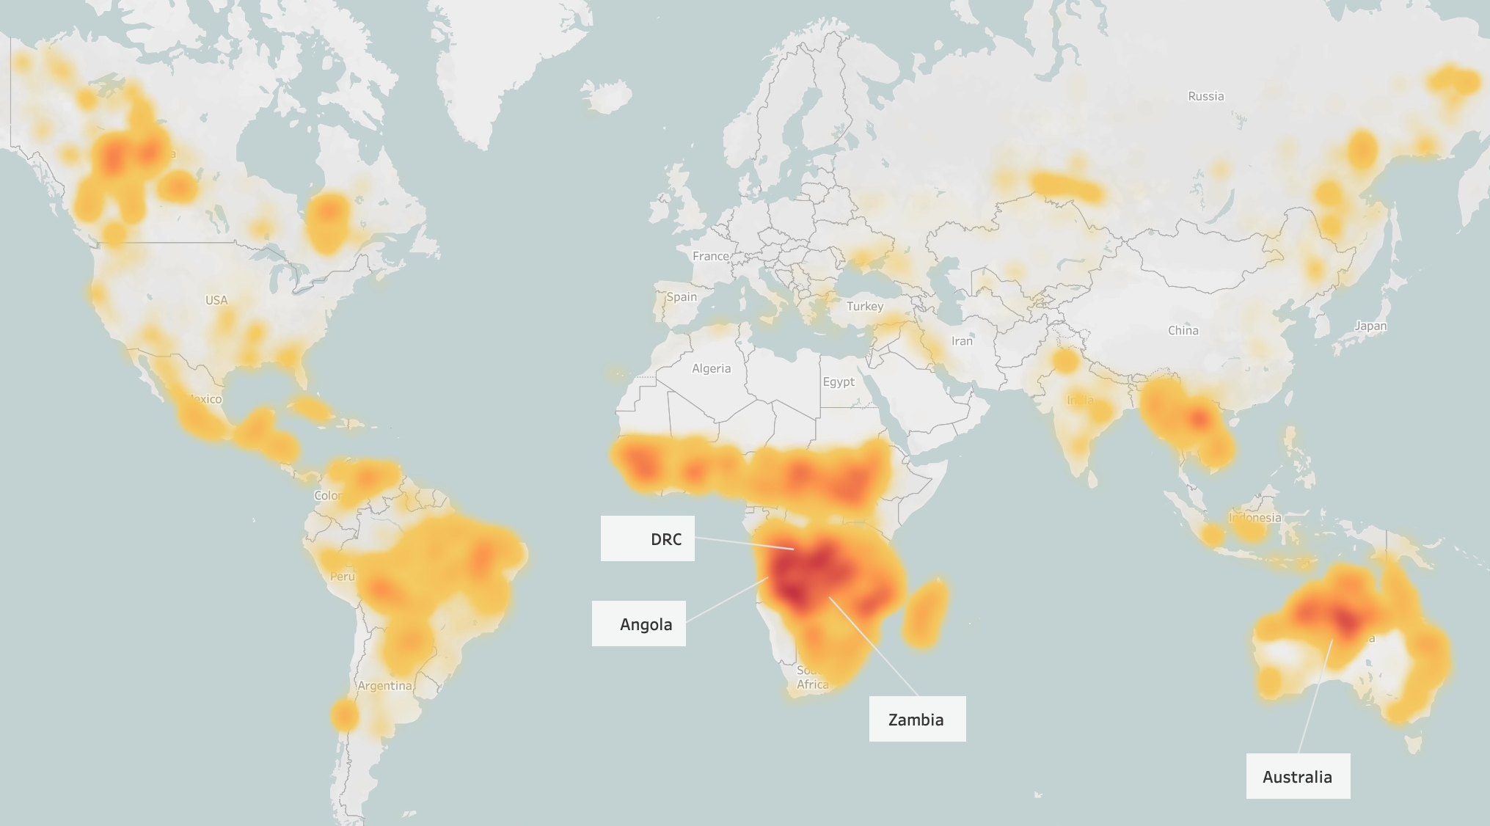
EXPLORATORY DATA ANALYSIS
Wildfire Hotspots:
Congo, Angola, Zambia
Australia
South America

Slide 7
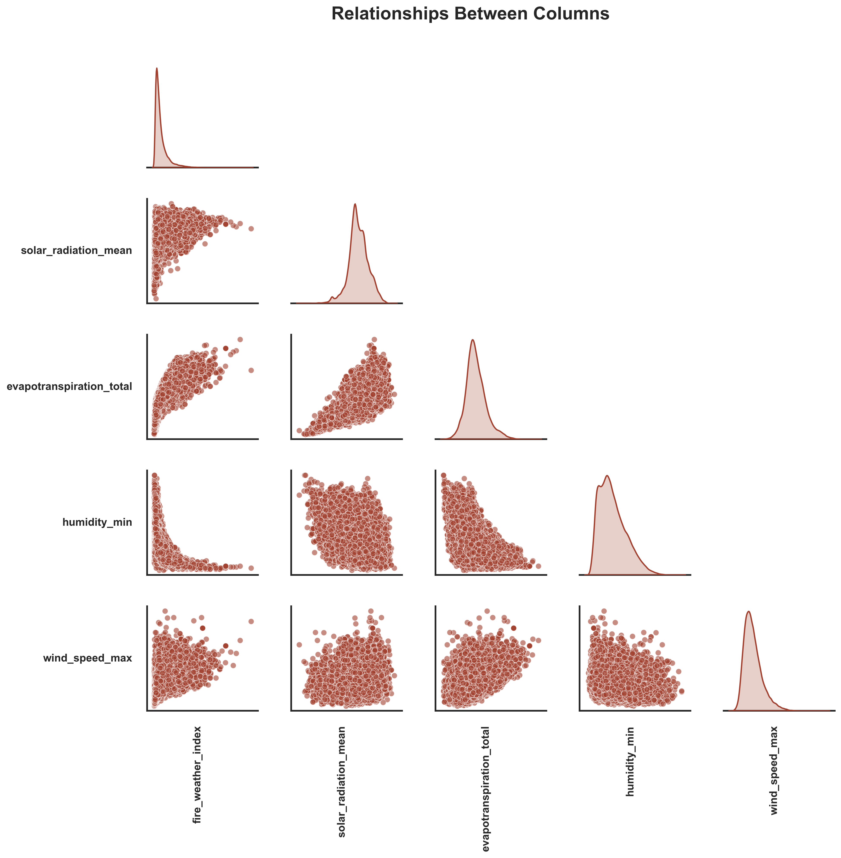
EXPLORATORY DATA ANALYSIS
Some columns were found to have non-linear relationships.
So logarithmic transformations were applied to these columns to improve model performance.

Slide 8
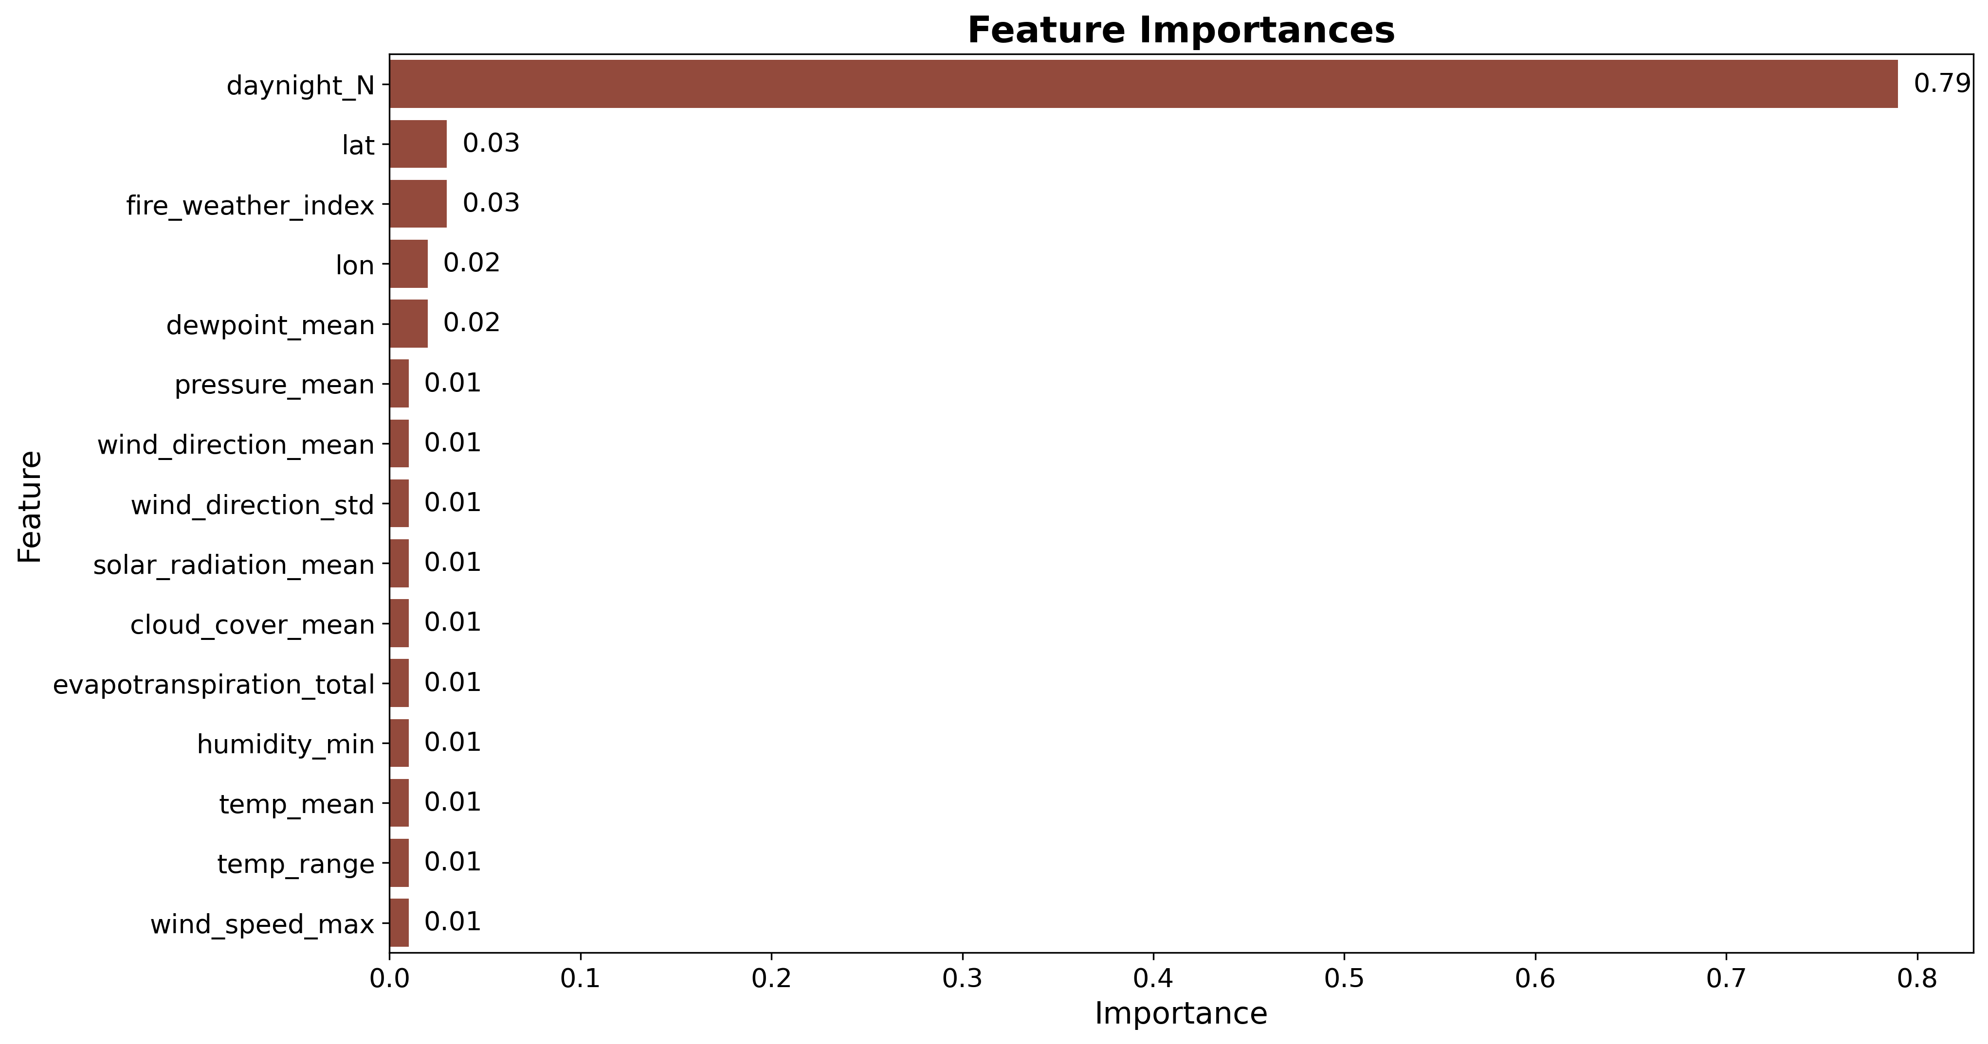
DATA EXPLORATION
The ‘daynight_N’ column – a binary column indicating whether it is day or night – had the highest feature importance.
Columns with a low feature importance were removed initially, but this negatively affected the model’s performance, so they were added back in.

Slide 9
THE MODEL
The model chosen was XGBoost due to its better performance over Logistic Regression and Random Forest.
XGBoost is a decision-tree model that builds many simple trees one after another, each one correcting the errors of the previous ones.
Advantages:
Faster
More accurate
Better at handling messy data

Slide 10
THE MODEL – Feature Reduction
The wildfire dataset has 17 columns and over 100,000 rows.
Two pipelines were explored to reduce the number of features:
Pipeline A
Investigating Collinearity
Feature Reduction
Using Principal Component Analysis (PCA)
Pipeline B

Slide 11
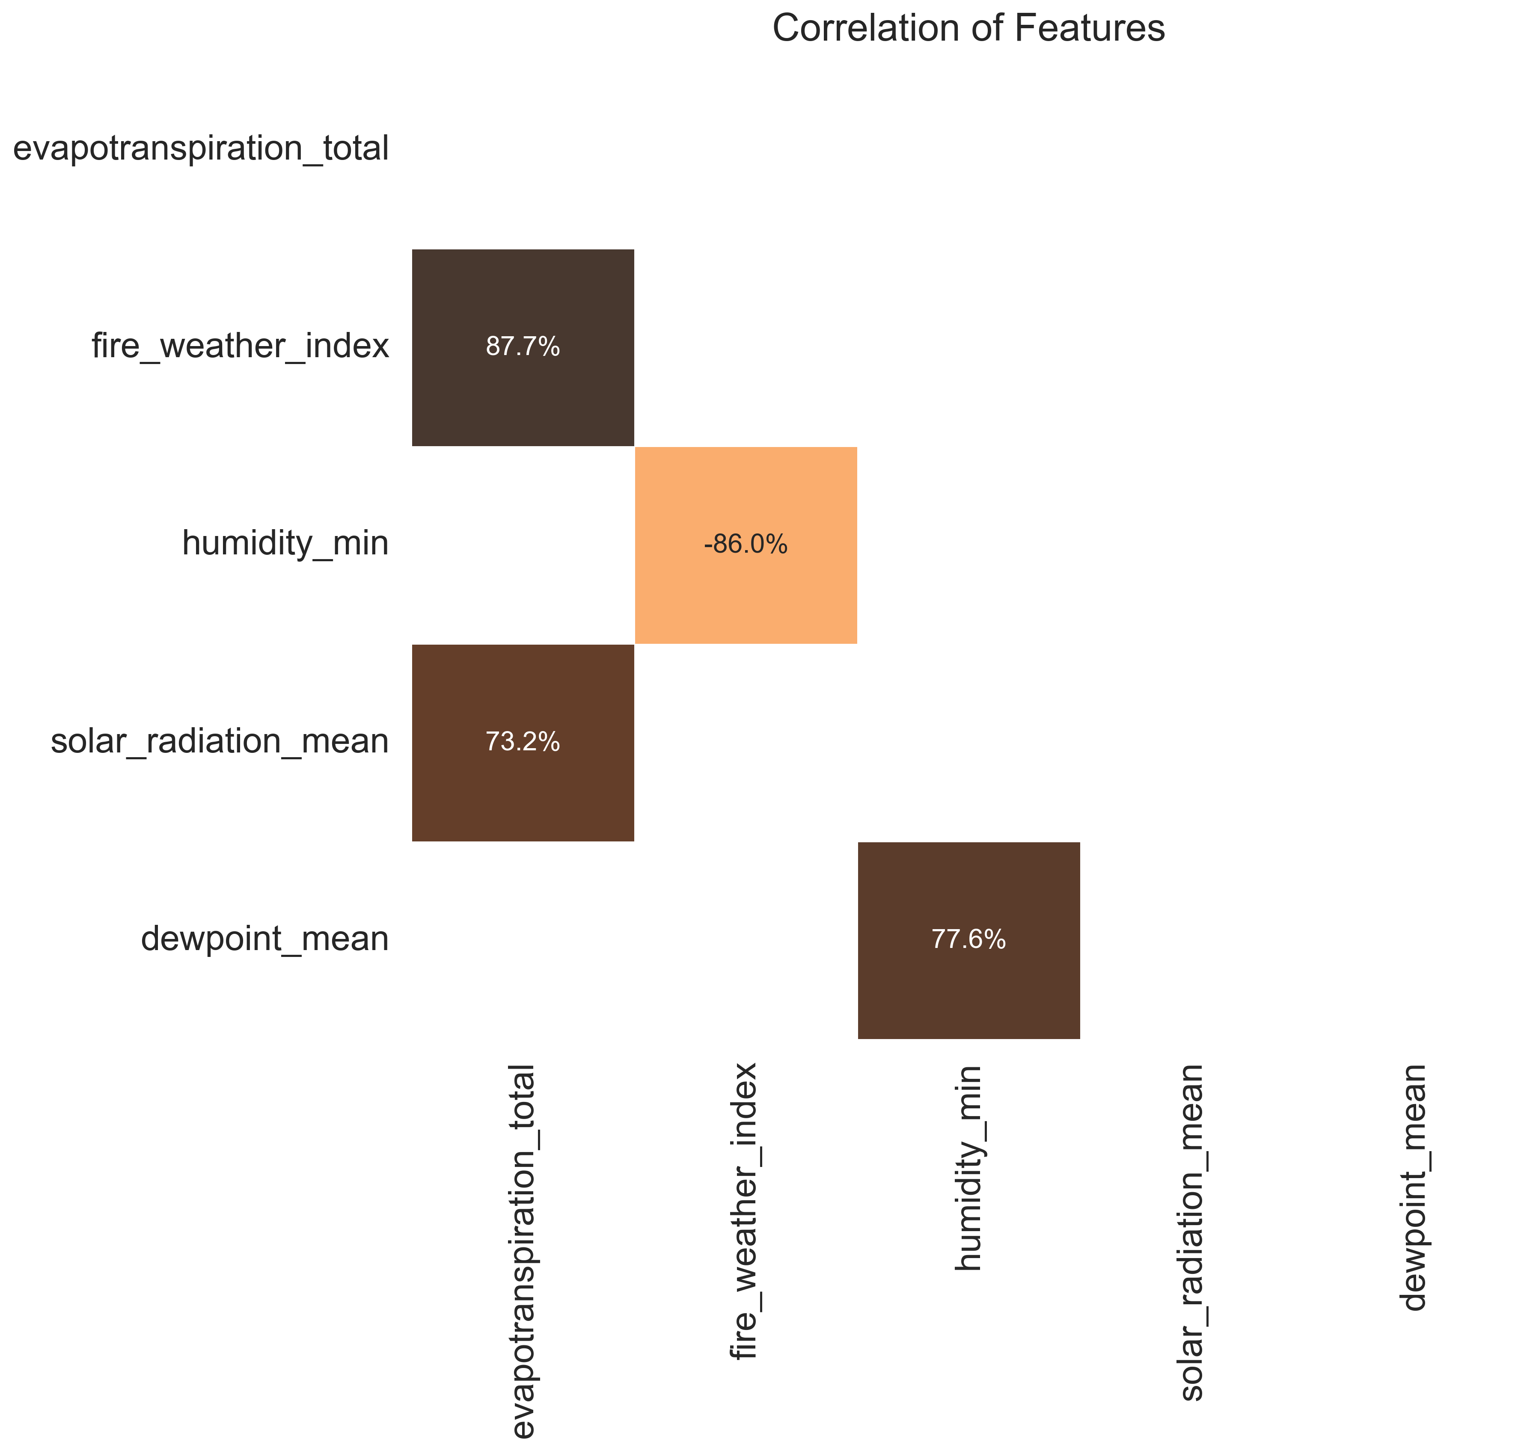
Pipeline A
Collinearity occurs when two features are very closely related.
1. Correlations were calculated between features
2. Variance-Inflation-Factor (VIF) scores were
calculated for features with high correlations
3. Columns with high VIFs were dropped from the
model.

Slide 12

Pipeline B
Principal Component Analysis (PCA) reduces the number of columns while keeping the important information.
How it Works:
1. Analyses features to find patterns in the data
2. Combines these into a smaller set of features
3. Keeps 95% of the variance in the data.
PCA performed better, so Pipeline B was chosen for the final model.

Slide 13
THE MODEL – Evaluation
Recall measures the proportion of actual wildfires that the model correctly identifies.
High recall means the model misses very few real wildfires. Since our goal is to support risk management, we prioritise catching as many real wildfires as possible.
To achieve this, the model’s classification threshold was set to 0.4 – any predicted probability of 40% or higher counts as a wildfire.

Slide 14
Results
94%
58%
71%
Recall
Precision
F1

Slide 15
DEMONSTRATION

Slide 16

Future Proofing
01
Incorporate multiple data sources with more relevant features
02
Extend the model to predict fire intensity
03
Extend the model to predict fire spread

Slide 17

CONCLUSION
The objective of predicting wildfire occurrence from environmental factors was achieved using an XGBoost model with a strong 94% recall.
Day/night emerged as the most influential feature, demonstrating the model’s potential for effective early warning and risk-management support.
Any Questions?

